Slide 1

Pattern Recognition
Decision Tree
Chumphol Bunkhumpornpat
Department of Computer Science
Faculty of Science
Chiang Mai University

Slide 2
Learning Objectives
How decision trees are used to choose the course of action
How decision trees are used for classification
The strength and weakness of decision trees
The splitting criterion used at the nodes
What is meant by induction of decision trees
Why pruning of decision tree is sometimes necessary

Slide 3
Decision Tree
The most popularly used data structure
Highly Transparent
User-Friendly Characteristics
  Continuous
  Categorical
    Nominal
    Ordinal

Slide 4
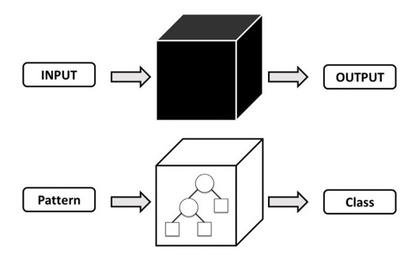
Highly Transparent

Slide 5
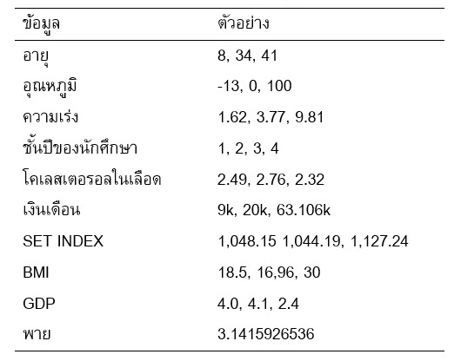
Continuous Feature

Slide 6
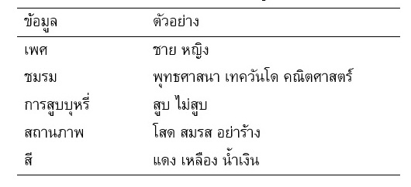
Nominal Feature

Slide 7
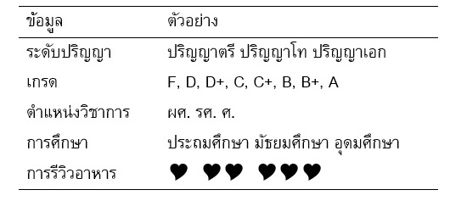
Ordinal Feature

Slide 8
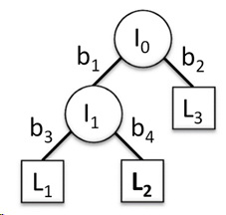
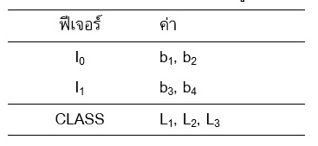
Decision Tree Components
Internal Node
Root
Leaf Node
Branch
  Mutually Distinct
  Collectively Exhaustive

Slide 9
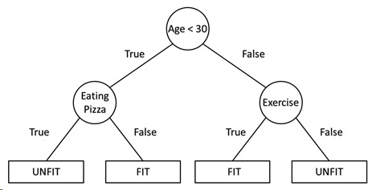
Example of Decision Tree

Slide 10
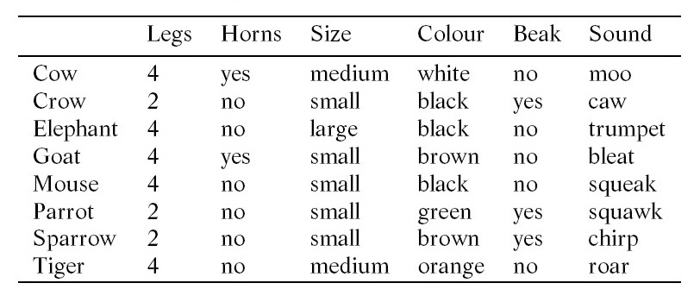
Descriptions of a Set of Animals
Irrelevant features do not occur in the decision tree.
  Sound is not needed for the discrimination of the patterns.

Slide 11
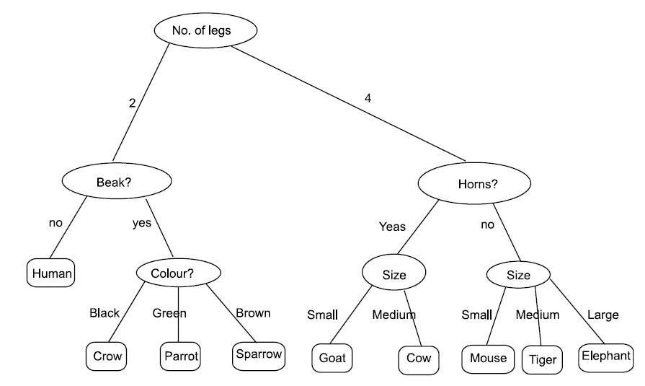
Decision Tree for Classification of Animals
Root to leaf represents a rule.
IF (no. of legs = 4) AND (has horns = false) AND (size = small) THEN (mouse)
Classification involves making
a decision at every node.
Numerical Feature
  Classification moves down
  the appropriate branch
  till we reach a leaf node.
Class labels
are associated
with leaf nodes.
Categorical Feature

Slide 12
A set of patterns is associated with each node
This set is larger at the top nodes and keeps reducing in size at subsequent levels.
Decision 2 legs contains only birds and human.

Slide 13
The rule are simple Boolean function and easy to understand
  Single Outcome
IF (no. of legs = 4) AND (has horns = false) AND (size = small) THEN (mouse)
  Conjunction of a number of Antecedents

Slide 14
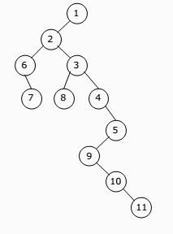
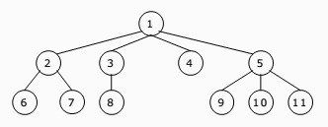
The tree can be binary or non-binary

Slide 15
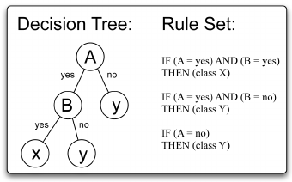
A many-way decision can be converted into a number of yes/no decisions

Slide 16
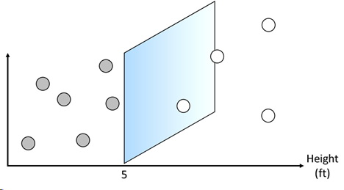
Axis-parallel Test x > a₀ : Height > 5 ft
Hyperplane
Threshold

Slide 17

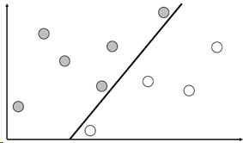
Test on Linear Combination of Features
: 0.4 Height + 0.3 Weight > 38

Slide 18
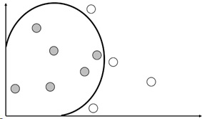
Test on Non-linear Combination of Features f(x) > 0

Slide 19
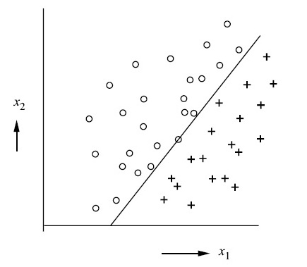
Non-Rectangular Decision Boundary

Slide 20
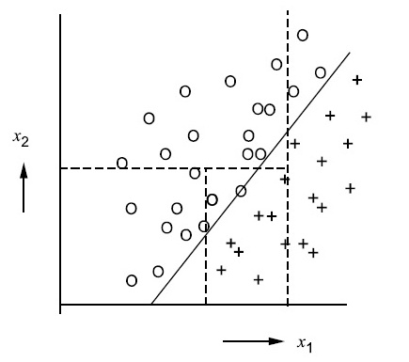
Decision Tree Performed on a Non-Rectangular Region

Slide 21
Construction of Decision Trees
The most discriminative attribute is used at the earliest level in the decision tree.
At each node, the set of examples is split up and each outcome is a new decision tree learning problem by itself.

Slide 22
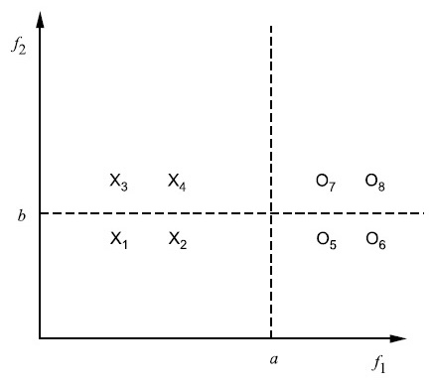
Classification into two classes:
An illustration
Discriminant Feature

Slide 23
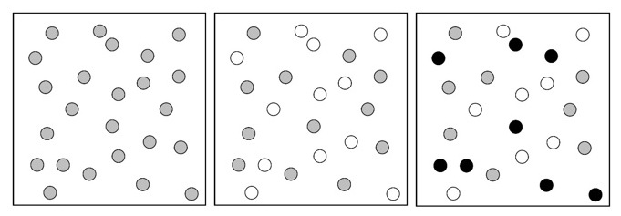
Impurity
Impurity = 0
Impurity = LOW
Impurity = HIGH

Slide 24

Entropy Impurity / Information Impurity
Fraction of patterns at node N of category w_{j}.

Slide 25
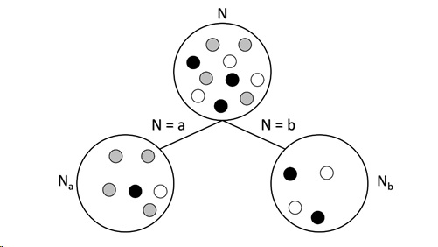
Node Splitting

Slide 26

Impurity Drop
N_{j} is the child node of N
The attribute which maximises ∆i(N) is to be chosen
Notes:
การลดค่าการเจือปน = เอนโทรปีของโหนด N – ผลรวมของเอนเทรปีของโหนดลูกของ N

Slide 27
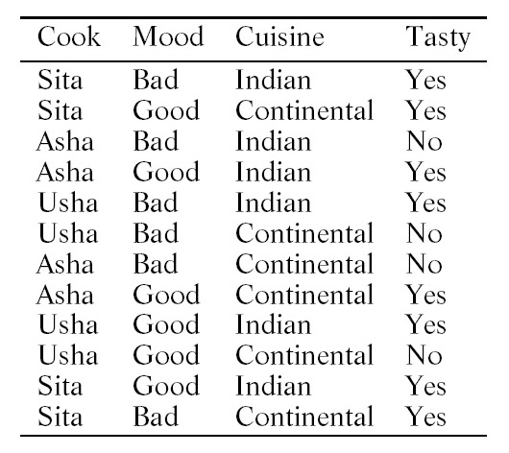
Example Training Data Set for
Induction of a Decision Tree

Slide 28
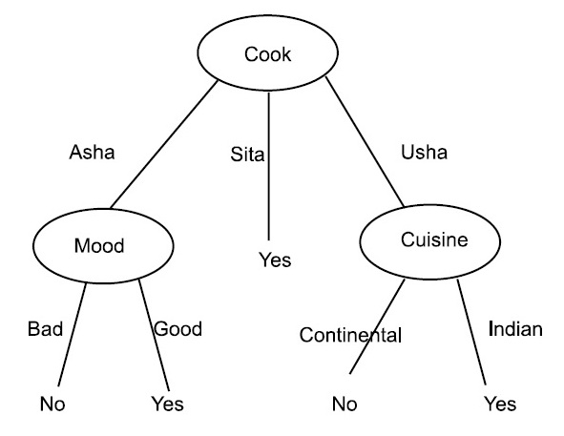
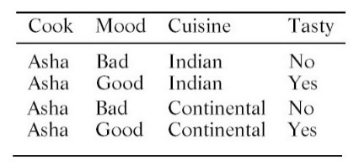
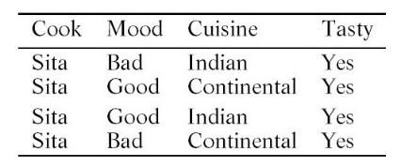
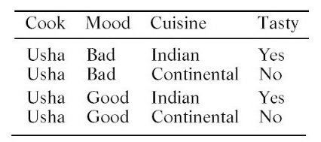
Cook = Sita : i(N_{S}) = – (4/4)log(4/4) = 0.0
Cook = Asha : i(N_{A}) = – (2/4)log(2/4) – (2/4)log(2/4) = 1.0
Cook = Usha : i(N_{U}) = – (2/4)log(2/4) – (2/4)log(2/4) = 1.0
∆i(N) = 0.9183 – (4/12)(1.0) – (4/12)(1.0) = 0.2516 -> MAX
i(N) = –(4/12)log(4/12) – (8/12)log(8/12) = 0.9183
Mood = Bad : i(N_{B}) = – (3/6)log(3/6) – (3/6)log(3/6) = 1.0
Mood = Good : i(N_{G}) = – (1/6)log(1/6) – (5/6)log(5/6) = 0.65
∆i(N) = 0.9183 – (6/12)(0.65) – (6/12)(1.0) = 0.0933
Cuisine = Indian : i(N_{I}) = – (1/6)log(1/6) – (5/6)log(5/6) = 0.65
Cuisine = Continental : i(N_{C}) = – (3/6)log(3/6) – (3/6)log(3/6) = 1.0
∆i(N) = 0.9183 – (6/12)(0.65) – (6/12)(1.0) = 0.0933
i(N_{A}) = 1.0
Mood = Bad : i(N_{AB}) = – (2/2)log(2/2) = 0.0
Mood = Good : i(N_{AG}) = – (2/2)log(2/2) = 0.0
∆i(N_{A}) = 1.0 -> MAX
i(N_{S}) = 0.0
Cuisine = Indian : i(N_{AI}) =
– (1/2)log(1/2) – (1/2)log(1/2) = 1.0
Cuisine = Continental : i(N_{AI}) =
– (1/2)log(1/2) – (1/2)log(1/2) = 1.0
∆i(N_{A}) = 1.0 – (2/4)(1.0) – (2/4)(1.0) = 0.0

Slide 29
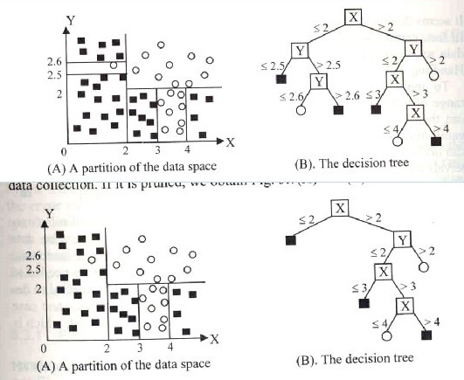
Over-fitting
Too Specific
Unique Root
Notes:
Whenever there is a large set of possible hypotheses, the tree can keep growing—thus becoming too specific.
One unique path through the three for every pattern in the training set.

Slide 30
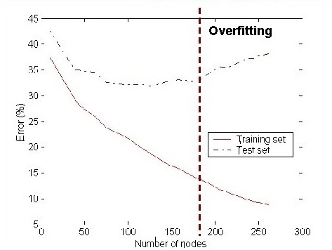

Slide 31
Under-fitting
When model is too simple, both training and test errors are large.

Slide 32
Over-fitting
Over-fitting results in decision trees that are more complex than necessary.
Training error no longer provides a good estimate of how well the tree will perform on previously unseen records.

Slide 33
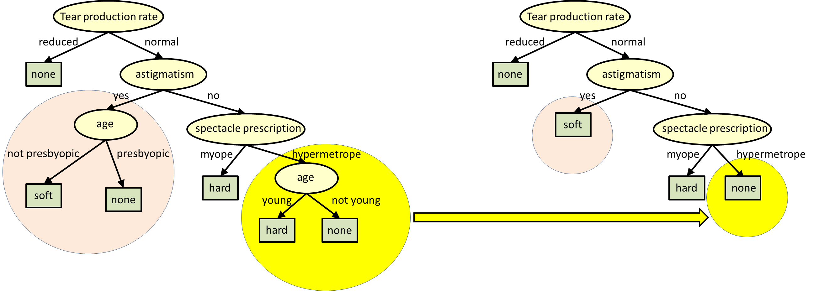
Algorithm for Pruning
Catalog all twigs in the tree
Count the total number of leaves in the tree
While the number of leaves in the tree exceeds the desired number:
  Find the twig with the least Information Gain
  Remove all child nodes of the twig
  Relabel twig as a leaf
  Update the leaf count
Notes:
ขั้นตอนวิธีสำหรับการเล็มกิ่ง:
เก็บกิ่งทั้งหมดลงโครงสร้างข้อมูล
นับจำนวนโหนดใบทั้งหมด
ในขณะที่จำนวนของโหนดใบยังเกินจำนวนที่ผู้ใช้กำหนด:
ค้นหากิ่งย่อยที่มีค่าเกนข่าวสารต่ำที่สุด
ลบโหนดลูกทั้งหมดภายใต้กิ่งย่อยนี้
เพิ่มโหนดใบภายใต้กิ่งย่อยนี้
ปรับปรุงค่าจำนวนโหนดทั้งหมด

Slide 34
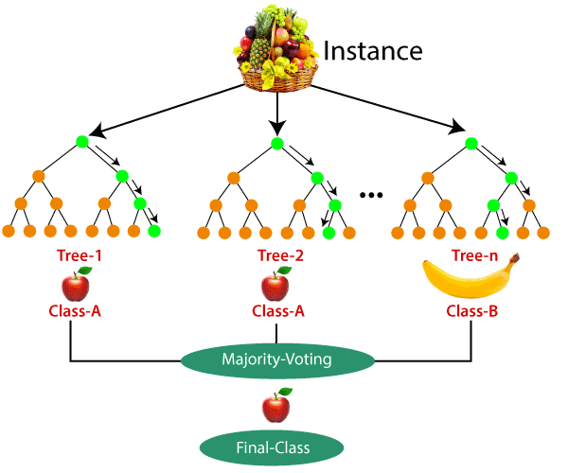
Random Forest

Slide 35
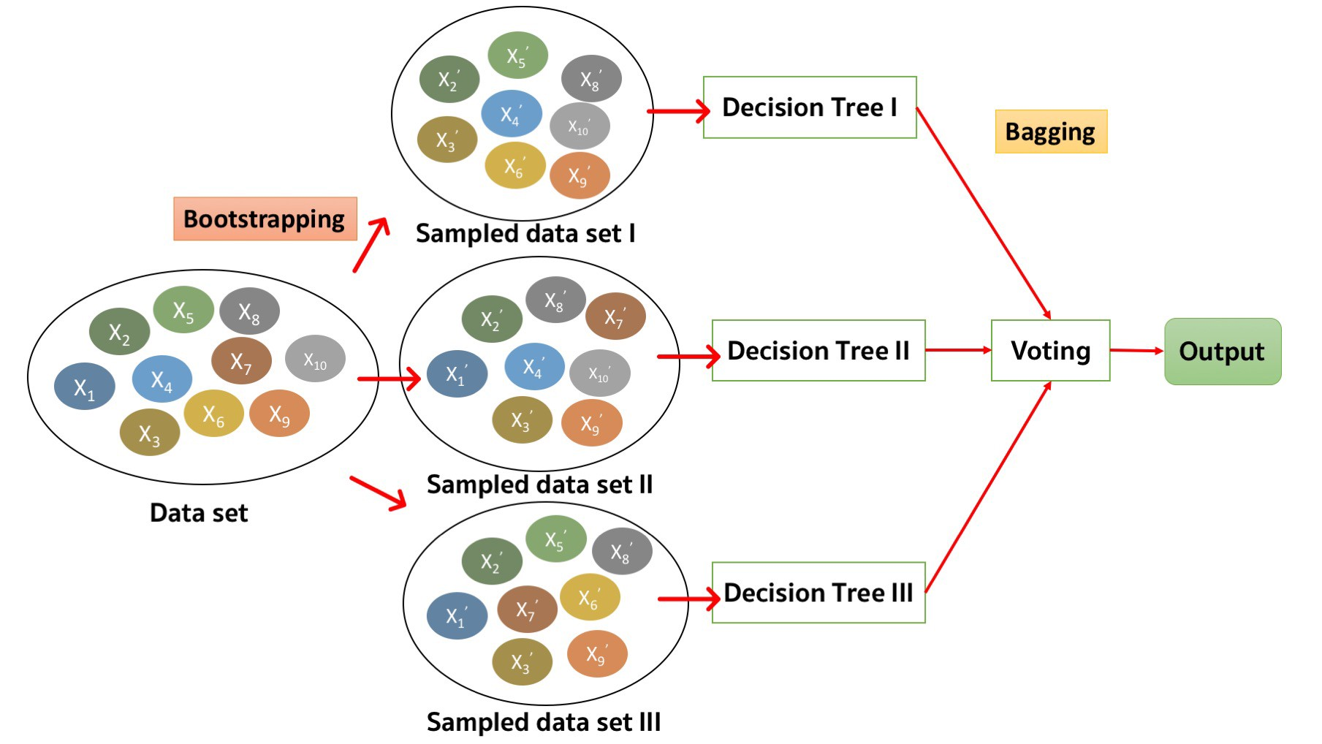
Random Forest

Slide 36
Reference
Murty, M. N., Devi, V. S.: Pattern Recognition: An Algorithmic Approach (Undergraduate Topics in Computer Science). Springer (2012)
https://slidetodoc.com/decision-trees-and-decision-tree-learning-philipp-krger/
https://medium.com/@witchapongdaroontham/

Slide 37
Logarithm Formula
log_{a} 1 = 0
log_{a} a = 1
log_{a} a^{b} = b
log_{a} (b/c) = log_{a} b – log_{a} c
log_{a} b = log_{c} b / log_{c} a

Slide 38
LightGBM
Light GBM is a gradient boosting framework that uses tree-based learning algorithm.
Light GBM grows tree vertically while other algorithm grows trees horizontally meaning that Light GBM grows tree leaf-wise while other algorithm grows level-wise.

Slide 39
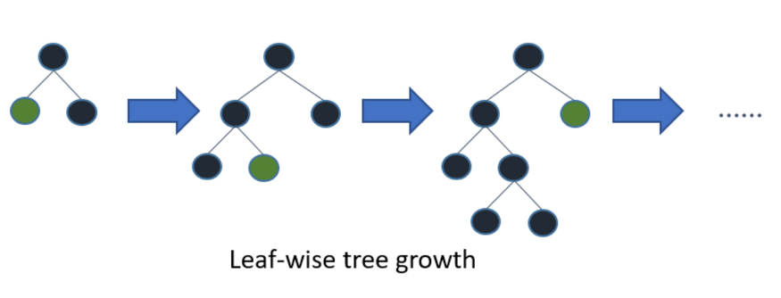
Explains how LightGBM works

Slide 40
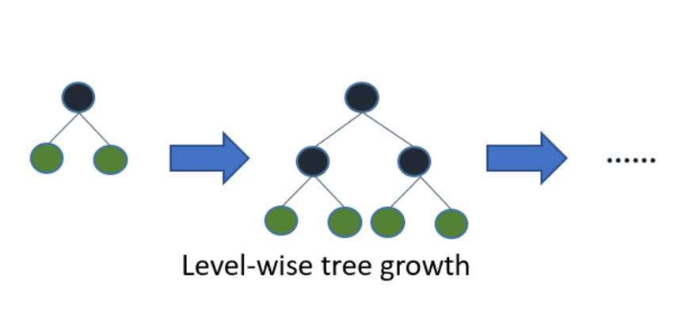
How other boosting algorithm works

Slide 41
Why Light GBM is gaining extreme popularity?
High speed
Handle the large size
Takes lower memory to run
Focuses on accuracy of results
Supports GPU learning

Slide 42
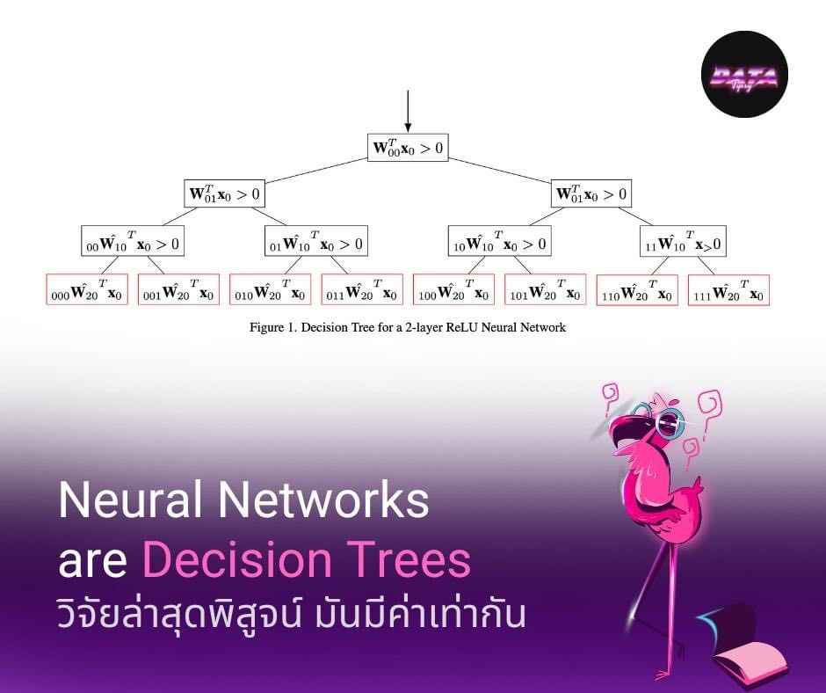

Slide 43
Reference
Murty, M. N., Devi, V. S.: Pattern Recognition: An Algorithmic Approach (Undergraduate Topics in Computer Science). Springer (2012)
https://medium.com/@pushkarmandot/https-medium-com-pushkarmandot-what-is-lightgbm-how-to-implement-it-how-to-fine-tune-the-parameters-60347819b7fc
https://arxiv.org/pdf/2210.05189.pdf

